Slide 1

Cooperative Nursery Unit Biosecurity
John Cingolani
Fisheries Technician

Slide 2
Biosecurity Protocols
Biosecurity protocols are designed to eliminate or minimize the risk of transferring diseases and pathogens throughout the nursery, from nursery to nursery, or back and forth between nursery and a PFBC hatchery.
Reducing the number of disease outbreaks within a facility generally results in better growth and fewer mortalities each season.
Helps to ensure a more plentiful supply of bigger, healthier fish to stock into the waters of the Commonwealth.
Notes:
Biosecurity involves the exclusion of disease-causing organisms from the environment. This is particularly important in fish production. It is achieved using external and internal biosecurity barriers

Slide 3
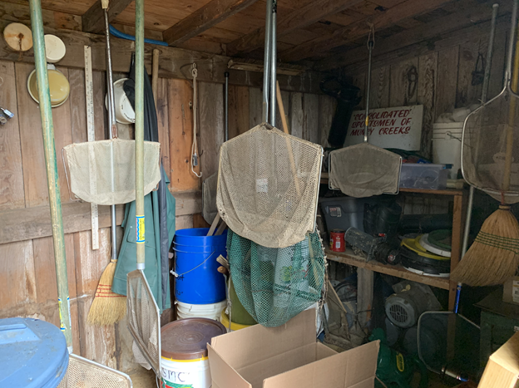
External Barriers
External Barriers - blocking the spread of disease into and out of a cooperative nursery.
  Water Source
  Boots and Waders
  Nets and Buckets
  Stocking Tanks, Trailers and Trucks

Slide 4
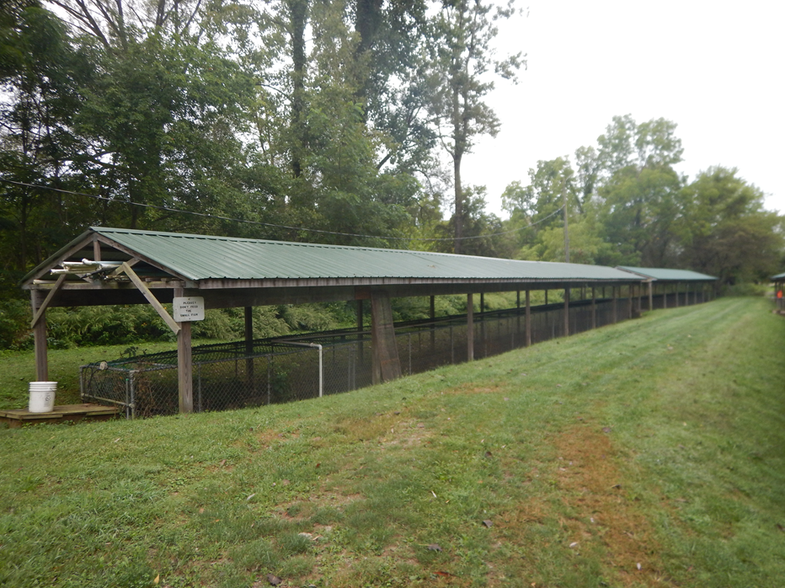
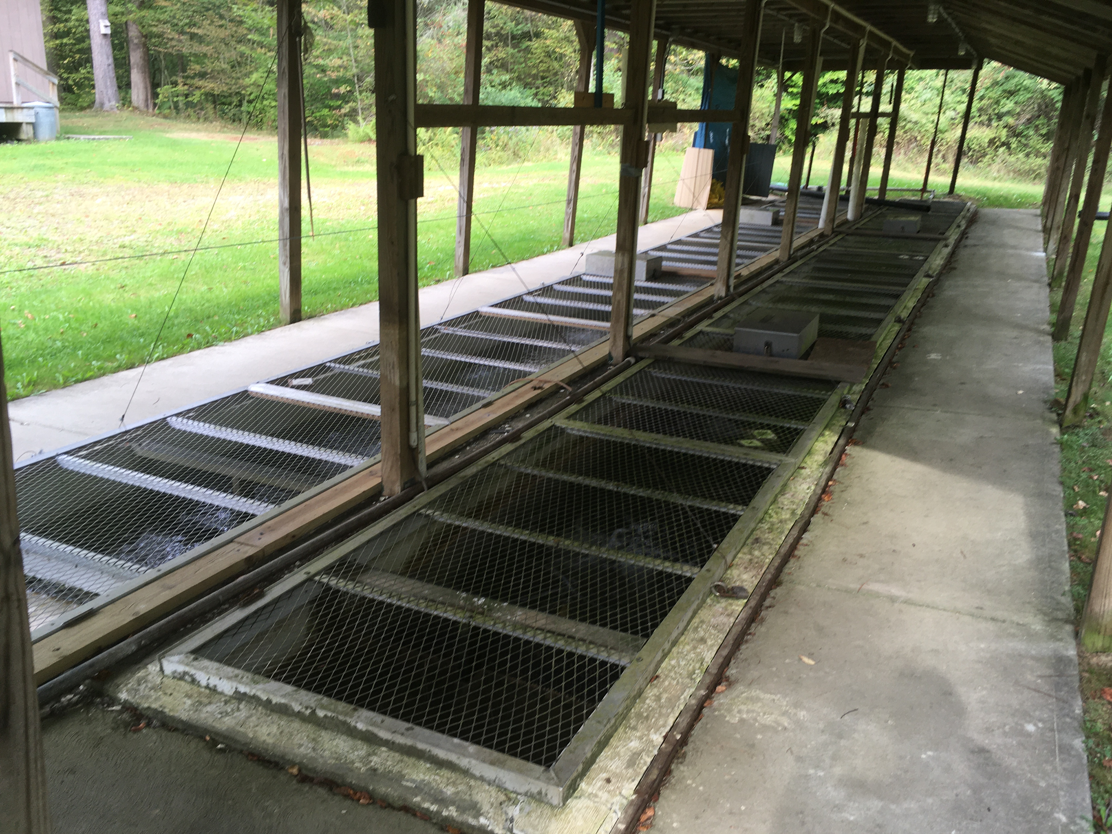
External Barriers
Water Sources
  Cover and fence water sources and raceways.
  Lessens the risk of disease transmission from birds.
  Reduces predation from mammals and prevents leaves and other debris from falling into the water.

Slide 5
External Barriers
Boots and Waders
  Maintain separate boots for nursery work and stocking.
  Boots should be disinfected or thoroughly dried before using in the nursery.
Separate Buckets and Nets for Stocking Only
  Disinfect and Allow equipment to dry prior to and after stocking.
  All Stocking equipment should be well labeled.
  Store in an area away from daily nursery equipment.

Slide 6
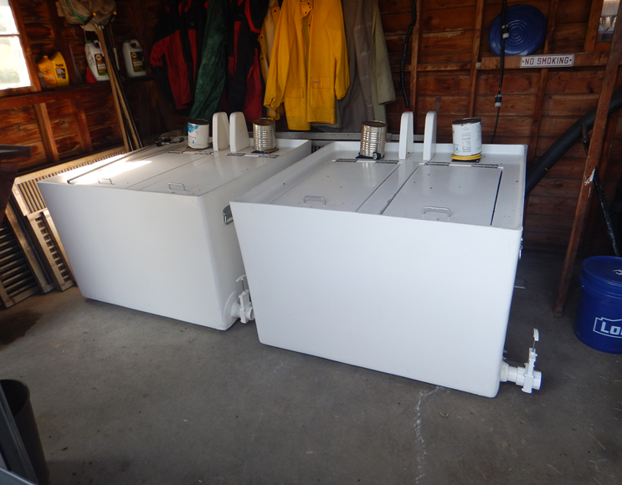
External Barriers
Stocking Tanks, Trailers and Trucks
  When possible, use nursery water to fill stocking tanks.
  Stocking tank water should always be drained at stocking site before returning to the nursery.
  Store Stocking equipment away from general daily nursery gear

Slide 7
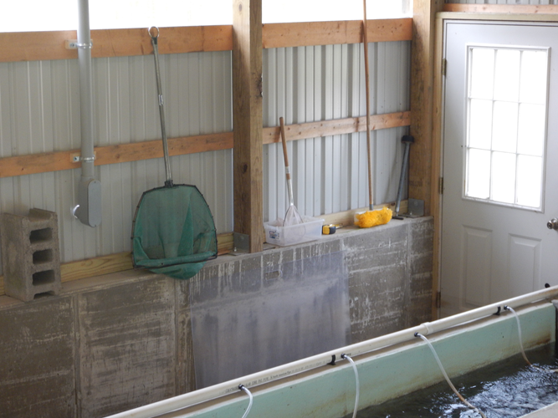
Internal Barriers
Internal Barriers - blocking the spread of disease within the cooperative nursery.
  Raceway Cleaning
  Nets and Brushes
  Mortalities
  Holdovers

Slide 8
Internal Barriers
Raceway Cleaning
  Frequent cleaning is essential for minimizing parasite, bacterial, and fungal infections in fish of all year classes.
  Routine removal of fish waste and excess feed is the best way to reduce the available nutrient rich environment where infectious pathogens thrive.
  Try to remove small amounts of waste daily or every other day, rather than let the material accumulate to the point where dirty water passes over the fish for extended periods of time.
  After a thorough cleaning, a salt treatment of 0.5% to 1% of the water volume may help relieve stress to the fish caused by the cleaning.

Slide 9
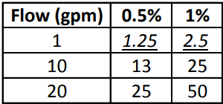
Salt Treatment Calculations
0.5% Salt Treatment for a 150 gallon per minute (gpm) water flow rate
  Lbs. of salt needed = 1.25 lbs. of salt x water flow (gpm)
  Lbs. of salt = 1.25 lbs. of salt x 150 gpm = 187.5 lbs. of salt
1.0% Salt Treatment for 30 gallons per minute flow
  Lbs. of salt = 2.5 lbs. of salt x water flow (gpm)
  Lbs. of salt = 2.5 lbs. of salt x 30 gpm = 75 lbs of salt
Avoid using
  Rock salt
  Water softener salt
  Salt block

Slide 10
Internal Barriers
Nets and Brushes
  Separate equipment should be used for separate water sources or flows.
    If possible, separate nets and brushes should be maintained for each species of fish and crossover should be avoided.
  Nets used for stocking should not be used for nursery work.
    Nursery nets should be disinfected daily.
    Net handles made of fiberglass or plastic are more desirable because they dry more efficiently.
  Color-coding, numbering, and labeling equipment to match individual species, raceway section, or specific use is the most effective way of preventing cross-contamination.

Slide 11
Internal Barriers
Mortalities
  Dead fish harbor pathogens and should be removed daily.
  Always work from the most upstream portion of the nursery downstream when removing mortalities.
    This will help prevent bringing parasites or diseases upstream from below.
  Use separate nets for each species or section if possible.
  Be sure to record mortalities daily to follow trends.

Slide 12
Internal Barriers
Holdovers
  Fish kept in the raceway for longer than one year.
  The CNU does not recommend keeping holdover fish
    Holdover fish can serve as reservoirs or carriers of various bacterial and viral diseases, which can be transmitted to the yearling fish, causing increased mortalities.
    These mature fish are also susceptible to losses from contagious fungal infections due to spawning stress.
    If holdovers are kept, they should be placed at the most downstream part of the nursery, using separate nets and brushes for daily maintenance.

Slide 13
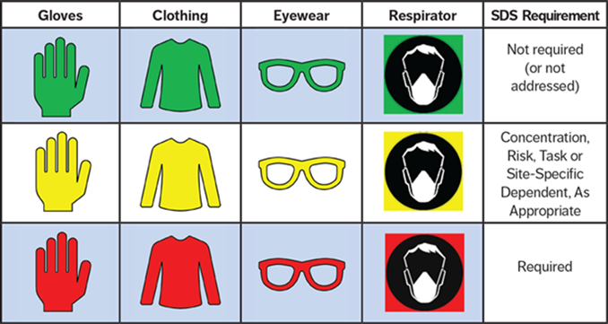
Disinfectant Selection
There are three key factors that must be considered when selecting a disinfectant for cooperative nursery biosecurity:
  Proven Efficacy
  Environmental Impact
  Operator Safety
Notes:
Proven Efficacy
Not all disinfectants are effective against the wide range of viral, bacterial and fungal disease-causing organisms that affect fish production.
Disinfectants with similar chemistry can have widely different ranges of activity and effective dilution rates.
Environmental Impact
As well as being effective, it is important that the disinfectant causes no harm to the environment in which it is being used.
Operator Safety
Given the exposure limits and dangers associated with the use of some disinfectants, consideration must be paid to operator safety.

Slide 14
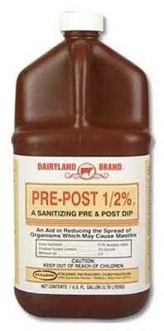
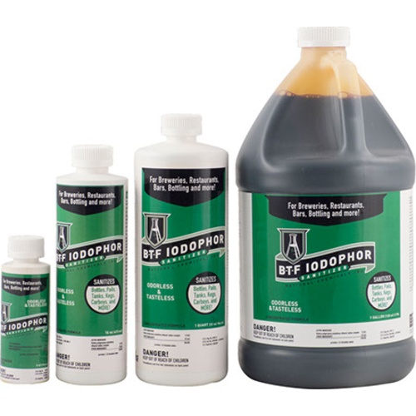
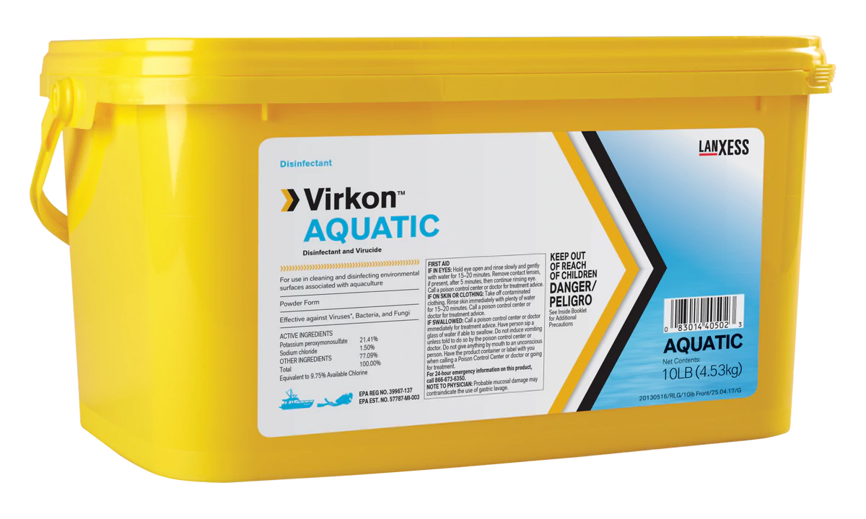
Disinfectant Selection
Iodophor and Virkon Aquatic are recommended for all parts of cooperative nursery disinfections and aquaculture use.
Notes:
The correct use and selection of disinfectants is very important
Ensures that pathogen challenge is minimized and Maximizes the fish's natural defense against infection.
This in turn will dramatically reduce incidences of disease, reducing mortality and saving you money.

Slide 15
Daily Disinfection
Nets/Brushes/Stocking Equipment
A 250 ppm Iodophor solution.
  An easily obtainable form of this Iodophor is Udder –Dyne, 1% active iodine liquid, which is used in the dairy industry and is readily available at agriculture supply stores.
  Nets and Brushes must be in contact with the iodophor for 10 minutes.
Virkon® Aquatic
  A powder disinfectant that is very effective. Wear a dust mask, rubber gloves, and eye protection when mixing Virkon® Aquatic powder.
  The proper contact time for Virkon® Aquatic is 20-30 minutes.

Slide 16
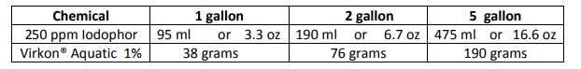
Disinfection Amounts
The table below lists the amount of chemical required to obtain the proper concentration for one-, two-, and five-gallon solutions.
Both disinfectants can also be used in a spray bottle, easily taken into the field and used to disinfect equipment while stocking.
For both the dip bucket and spray bottle applications, these disinfectant solutions have an effective lifespan of about 1 week.

Slide 17
Preventative Measures
Fish Transfers – The CNU does not recommend the transfer of fish from one nursery to another, due to the increased risk of spreading pathogens.
However, if a transfer is necessary, the CNU must be consulted prior to the move.
No fish will be transferred without a completed “Intra-nursery Request for Fish Transfer” authorization, approved by both the CNU Leader and the Fish Health Unit Leader.
All fish transferred should be relocated to the most downstream portion of the receiving nursery.

Slide 18
Preventative Measures
Purchasing Fish – Importing any commercial fish or fish not provided by the PFBC into a PFBC cooperative nursery is banned.
  Violations will result in expulsion from the program
Fish caught out in the wild are also Not Permitted into the nursery.
Dangers associated with any fish relocation:
  Bacteria
  Viruses
  Fungus
  Gill Lice
  Aquatic Invasive Species

Slide 19
Aquatic Invasive Species
Aquatic Invasive Species (AIS) are plants and animals that have been introduced into new ecosystems and have environmental, recreational, economic or health impacts.
Preventing their spread is important because once introduced, these species disrupt ecosystems, reduce biodiversity, and cost communities' huge amounts of time, money, resources, and lost revenue.
Invasive species drastically compete for food, shelter and breeding resources and prey on native species.

Slide 20
Aquatic Invasive Species
Aquatic Invasive species are often spread through innocent actions or activities like boating and fishing, or the active actions like release of aquarium pets or fishing bait into a local lake or waterway.
Aquatic invasive species are hitchhiking their way across Pennsylvania.
Prevent their spread by inspecting all stocking gear, a boat or trailer and remove any visible plants, animals, or organic materials before launching into a different stream, lake or pond.

Slide 21
Aquatic Invasive Species
Many AIS can't be seen and are microscopic. It's important to clean your gear even if it doesn't appear to have anything on it.
  Use hot (140° F) water to clean your equipment.
  Spray equipment with a high-pressure washer.
    a commercial hot water car wash also makes an ideal location to wash your boat, motor and trailer.
  Dry everything before entering new waters.
    Allow equipment to dry to the touch, and then allow it to dry another 48 hours.
  Freeze your equipment for 8 hours.
    Thick and dense material like life jackets and felt-soled wading gear will hold moisture longer, take longer to dry and can be more difficult to clean.

Slide 22
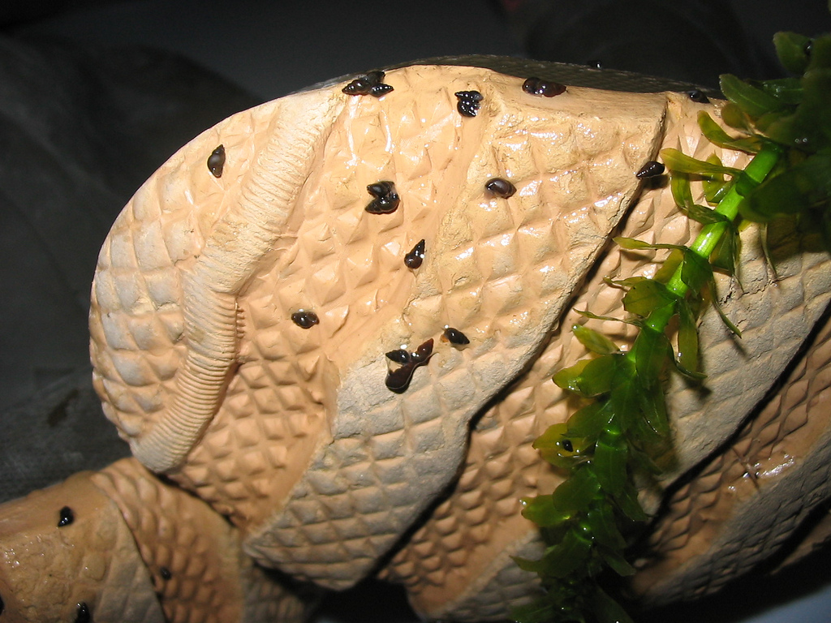
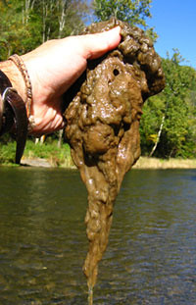
AIS to Look Out For When Stocking
New Zealand Mud snail
Didymo (Rock Snot)
FWS.gov
FWS.gov

Slide 23
Biosecurity Summary
Cover raceways and water sources.
Use different nets and buckets in the nursery from ones used when stocking fish.
Clean raceways frequently starting at the head and working towards the bottom discharge.
Remove mortalities daily and with separate nets for different water sources or by species separated in the raceway.
Clean and disinfect all equipment after use.
Recommended to not keep holdovers and DO NOT bring any other fish into the nursery!
Biosecurity Plan is available on Cooperative Nursery Program home page biosecurity_for_coops.pdf (fishandboat.com)

Slide 24
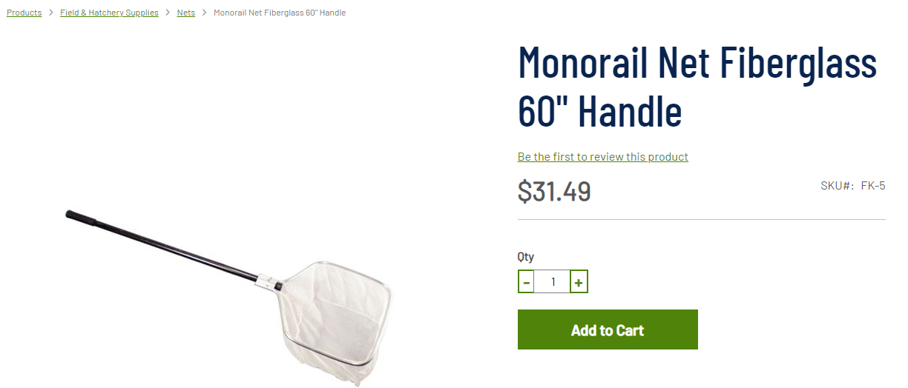
Purchasing Equipment
Where to purchase nets
Nets are available online at Pentair Aquatic Eco-Systems
We recommend this 60” monorail net with fiberglass handle.
Handles are easily removed with a pushbutton. Made in USA.
https://pentairaes.com/monorail-net-fiberglass-60-handle.html

Slide 25
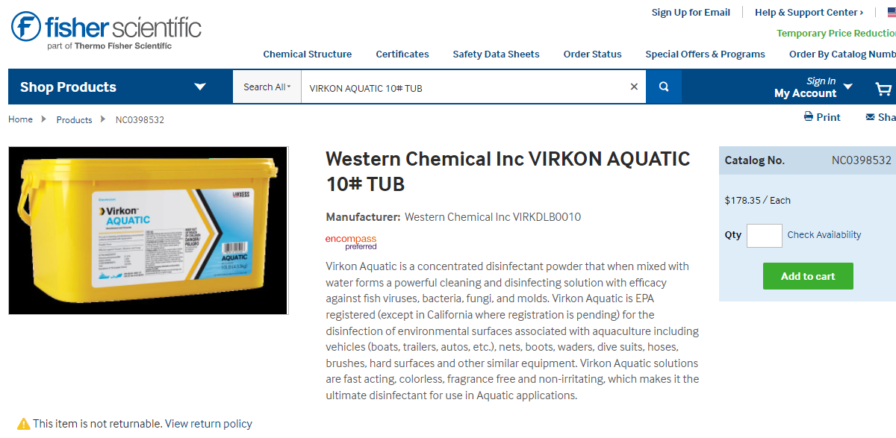
Purchasing Equipment
Where to purchase Virkon Aquatic
Virkon Aquatic is available online through Fisher Scientific under the name Western Chemical Inc VIRKON AQUATIC 10# TUB
https://www.fishersci.com/shop/products/virkon-s-10lb-tub/nc0480633

Slide 26
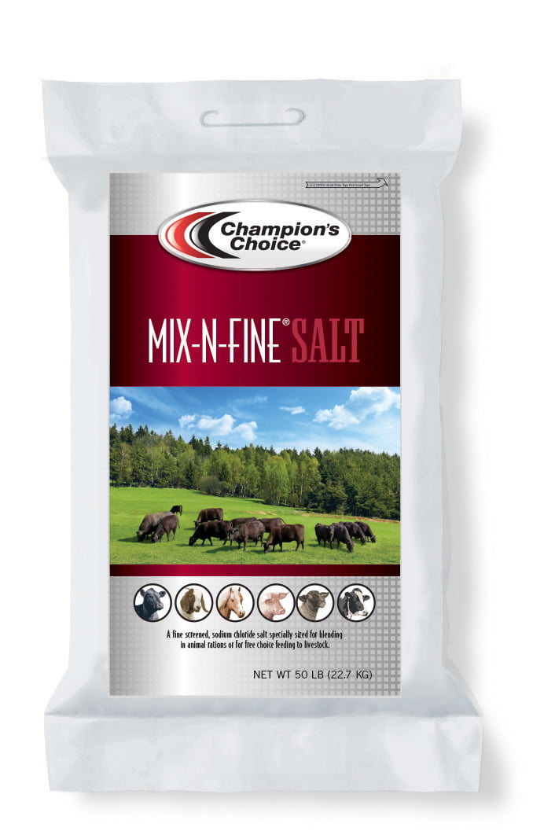
Purchasing Equipment
Where to purchase High Granular Mixing Salt
This fine-screened sodium chloride salt should be available at Tractor Supply Co. and other agricultural supply and livestock feed stores.

Slide 27
Questions
Questions regarding biosecurity?
  John Cingolani
  Email: jcingolani@pa.gov
  Office: 814-353-2237
  Mobile: 814-883-9177
  Pennsylvania Fish and Boat Commission
  Cooperative Nursery Unit
  1735 Shiloh Road
  State College, PA 16801

